Slide 1


CMR ENGINEERING COLLEGE
(UGC AUTONOMOUS)
(Accredited by NBA,Approved by AICTE NEW DELHI, Affiliated to JNTU, Hyderabad)
Kandlakoya, Medchal Road, Hyderabad-501 401.
Department of Computer Science & Engineering
A Mini Project
On
Best Streaming Shows Segmentation Analysis Using K-Means Clustering Algorithm
Presented By
Pandanaboina Shirisha : (218R1A05B3)
Jadala Manikanta : (228R5A0507)
Molangiri Srinath : (218R1A05A3)
Panuganti Pavani : (218R1A05B4)
Internal Guide:-Dr.B.Kishor, Associate Professor,
Dept. of CSE.
A.Y 2024-2025

Slide 2
Table of Content
Abstract
Introduction about Project
Literature survey
Existing System
Proposed System (Project Scope, Objectives, Modules)
Software Requirement Specification
Hardware Requirements
System Architecture
System Design
Testing strategies
Output screens
Future enhancements
Conclusion
References/Bibliography

Slide 3
Abstract
The rapid evolution of OTT streaming platforms necessitates data analysis to understand viewer patterns and improve content delivery. With a diverse catalog of TV shows across genres and languages, analyzing viewer preferences influenced by age, genre affinity, and platform accessibility is crucial. This project uses K-means clustering on an OTT TV shows dataset (including age suitability, IMDb ratings, Rotten Tomatoes scores, and platform availability) to reveal viewer segments and trends. Insights guide content acquisition, personalized recommendations, and targeted advertising, emphasizing the importance of data-driven strategies to enhance the OTT viewer experience.

Slide 4
Introduction
This project applies K-means clustering to analyze TV show data, exploring viewer preferences based on age suitability, IMDb ratings, Rotten Tomatoes scores, and platform availability to uncover patterns in content selection on OTT platforms.
Using K-means, this analysis identifies TV show clusters to understand correlations between content quality, age suitability, IMDb ratings, Rotten Tomatoes scores, and platform availability on OTT services, aiming to optimize content curation and platform strategies.

Slide 5
Literature Survey
S.NO | PAPER TITLE | YEAR PUBLISHED | ABSTRACT | METHODOLOGY | CONCLUSION
1 | Content-based Movie Recommendation System and Sentimental analysis using ML | 2023 | Recommendation systems suggest books, movies, music, and more based on user data, using criteria like genre, actors, or director. This paper employs content-based filtering with genre correlation for movie recommendations. | KNN algorithm, Cosine Similarity, Naive Bayes Classifier. | The content-based movie recommender with KNN and sentiment analysis personalizes suggestions; future upgrades include diverse ML methods and collaborative filtering.
2 | Recommendation Systems with Machine Learning | 2020 | Recommender systems use machine learning to suggest items. This paper develops and compares systems based on user, item, and interaction data. | Collaborative Filtering , Matchbox Recommender , RMSE (Root Mean Squared Error) | Tested on MovieLens20M, models using ML.NET and Azure ML were developed; future work includes continuous training and a big data module.

Slide 6
Literature Survey
S.NO | PAPER TITLE | YEAR PUBLISHED | ABSTRACT | METHODOLOGY | CONCLUSION
3 | Predicting IMDb Rating of Movies by Machine Learning Techniques | 2019 | This study predicts IMDb ratings using machine learning algorithms on Hollywood movies data from Wikipedia and IMDb, showing strong performance. | Linear Regression, Decision Trees, KNN, Support Vector Machines (SVM). | The model effectively predicts IMDb ratings using machine learning, and can be adapted for other rating platforms and media.
4 | Video Streaming OTT Platforms: A Comparative Study of their Streaming Infrastructure with Strategies Implemented | 2022 | This paper explores strategies of OTT platforms in India, focusing on content acquisition, personalization, market expansion, and regulatory compliance. | Content-Based Filtering, Regression Models,NLP. | Effective content strategy, personalization, market expansion, and compliance with regulations are crucial for OTT platforms' success in India.

Slide 7
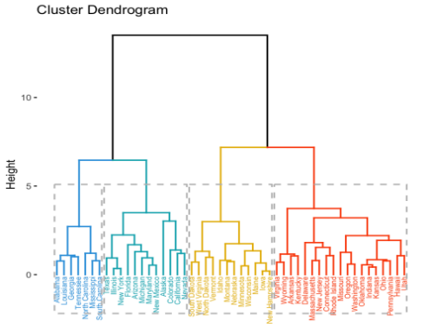
Existing system
AGGLOMERATIVE HIERARCHICAL CLUSTERING ANALYSIS
Hierarchical clustering is another unsupervised machine learning algorithm, which is used to group the unlabeled datasets into a cluster and also known as hierarchical cluster analysis.
The method can be sensitive to noise and outliers, which can impact the accuracy and structure of the dendrogram.
Provides the movies randomly by clustering related content into one cluster.

Slide 8
Drawbacks Of Existing System
Computational Complexity
Scalability Issues
Sensitivity to Noise and Outliers
Fixed Number of Clusters
Limited Scalability
Potential Accuracy Issues
Lack of Flexibility

Slide 9
Proposed System
It cluster the movies and ratings according to similarity.
It analyze that on which time what type of movies are getting high rating and most people are watching.
Based on the rating the movies will be released into OTT platforms.
By this it will very helpful to producers and content providers by getting large collections.also useful for the people they can watch the movies according to their preferences.
K-means clustering algorithm is used which clusters data by minimizing intra-cluster distances via centroid optimization

Slide 10
Advantages of Proposed System
Efficiency
Scalability
Flexibility in Cluster Number
Clear Interpretation
Optimal Cluster Selection
Robustness to Noise and Outliers

Slide 11
Project Scope
The project employs K-means clustering to categorize TV shows based on age suitability, IMDb ratings, Rotten Tomatoes scores, and platform availability.
The goal is to identify distinct clusters of TV shows that reflect different viewer engagement and platform preferences in the OTT streaming landscape.

Slide 12
Objective
Segment TV shows based on viewer preferences for targeted content understanding.
Guide content creators and platforms with insights into resonant content types.
Enhance viewer satisfaction through personalized content recommendations.
Analyze correlations between critical ratings and viewer satisfaction.
Improve competitive positioning of OTT platforms with enhanced viewer insights.

Slide 13
Modules
Data collection &preprocessing
Exploratory Data Analysis
Feature Selection and Engineering
K-means clustering
Insight Generation and Analysis
Visualization and Reporting

Slide 14
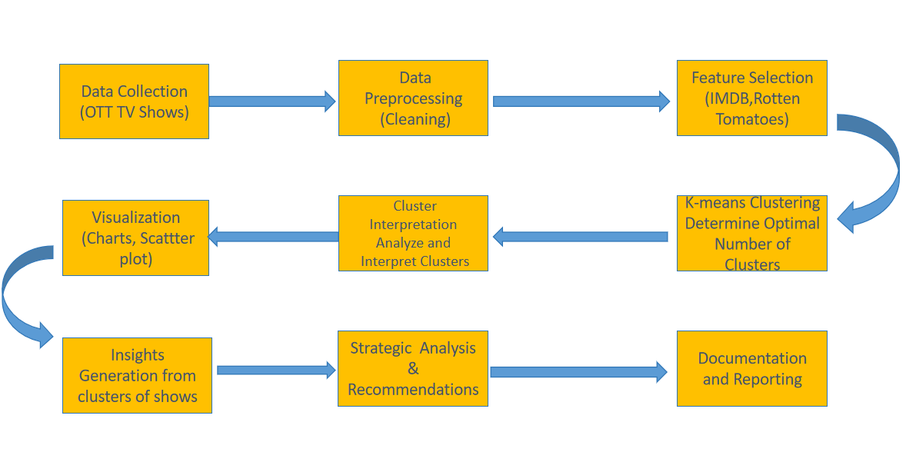
System Architecture

Slide 15
Software Requirements
Operating System | Windows 10/11
Development Software | Python 3.7
Programming Language | Python
Integrated Development Environment(IDE) | Visual Studio Code
Data Formats | CSV/Excel
Domain | Machine learning

Slide 16
Hardware Requirements
System/Processor (CPU) | i5 Processor 11th Generation
Memory (RAM) | 8GB
Hard Disk | 128GB - 500GB

Slide 17
SYSTEM DESIGN

Slide 18
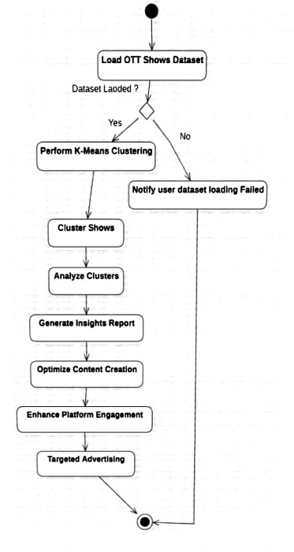
Activity Diagram

Slide 19
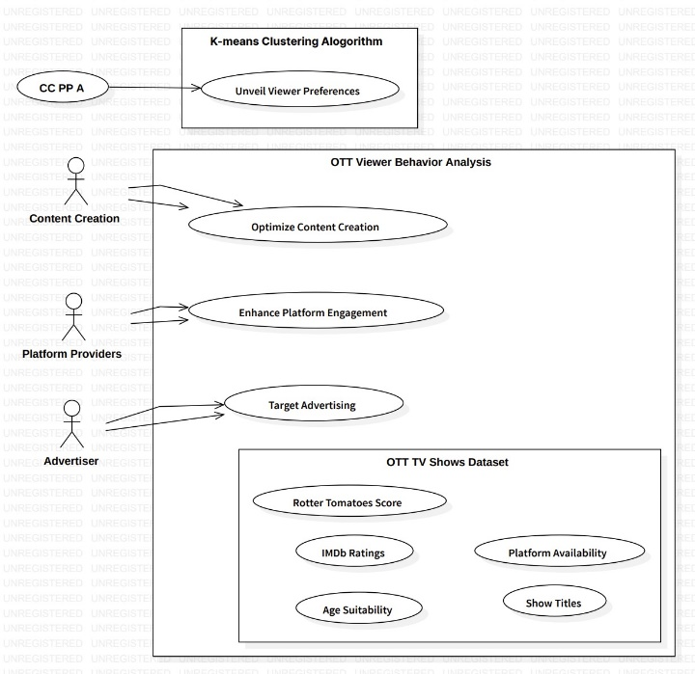
Usecase Diagram

Slide 20
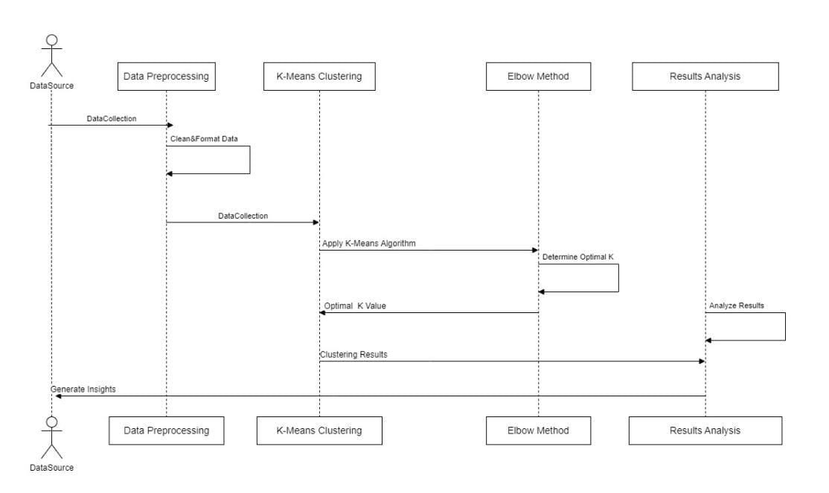
Sequence Diagram

Slide 21
Testing strategies
Unit Testing
Unit testing focuses on validating the smallest testable parts of an application, known as units, to ensure they function correctly in isolation. By designing test cases that examine internal logic, inputs, and outputs, unit testing verifies that all decision branches and code flows operate as expected. This structural testing is performed after the completion of an individual unit but before integration with other components. It is an invasive, code-aware process that verifies whether each unique path in a business process adheres to documented specifications, with clearly defined inputs and anticipated results.

Slide 22
System Testing A type of testing that verifies the complete and integrated system to ensure it meets the specified requirements. It checks the system's overall functionality and performance. White Box Testing: Testing based on the internal structure of the application, where the tester knows the code and design. It focuses on verifying the flow of inputs through the code. Black Box Testing: Testing where the internal workings of the application are not known to the tester. It focuses on validating the system's outputs based on various inputs.

Slide 23
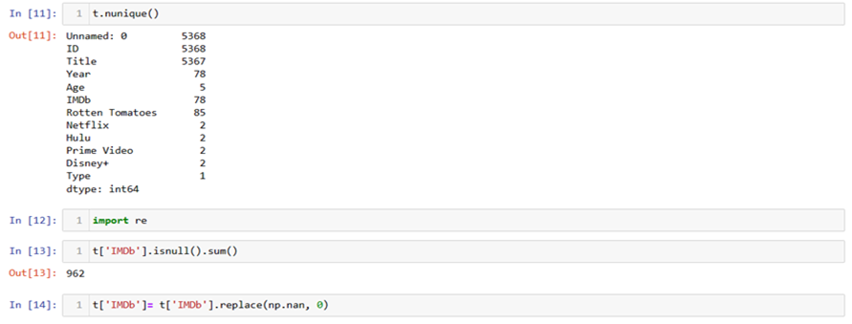
Output Screens

Slide 24
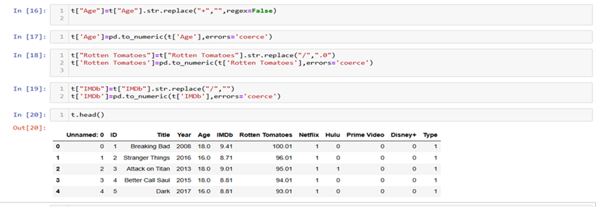
.

Slide 25
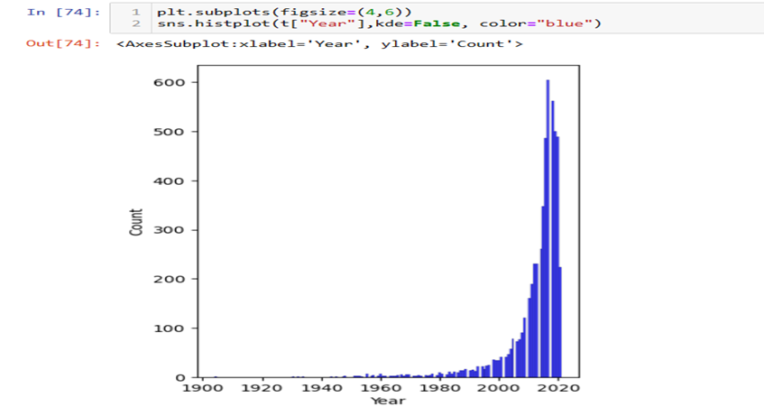

Slide 26
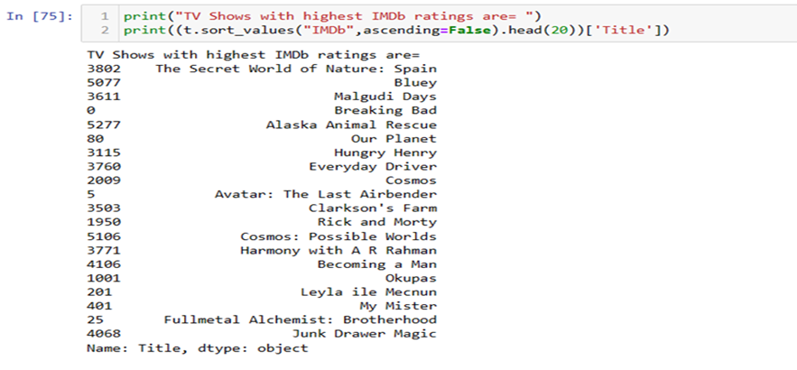

Slide 27
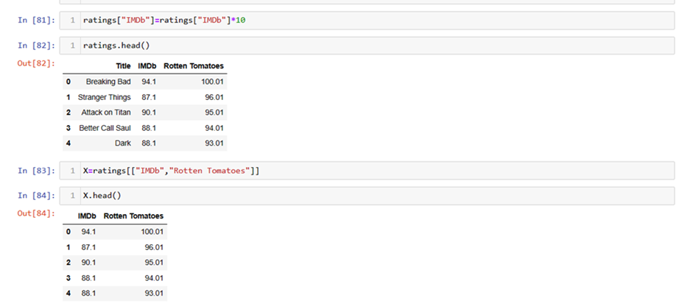

Slide 28
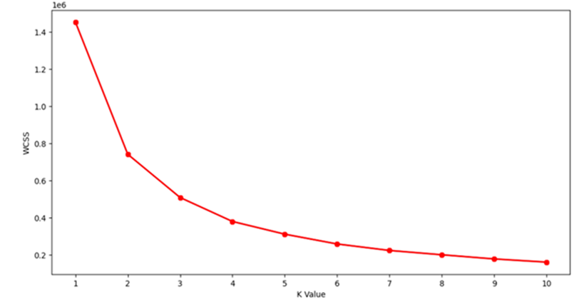

Slide 29
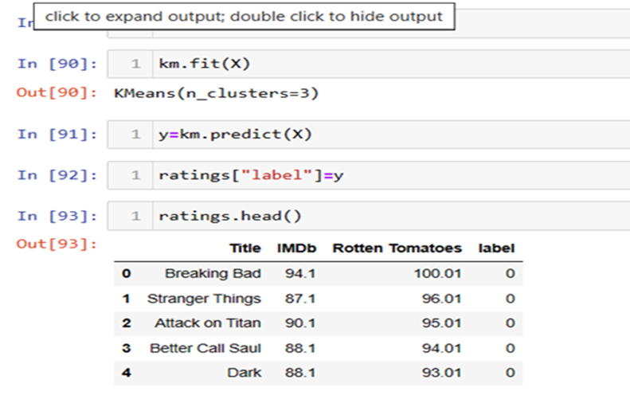

Slide 30
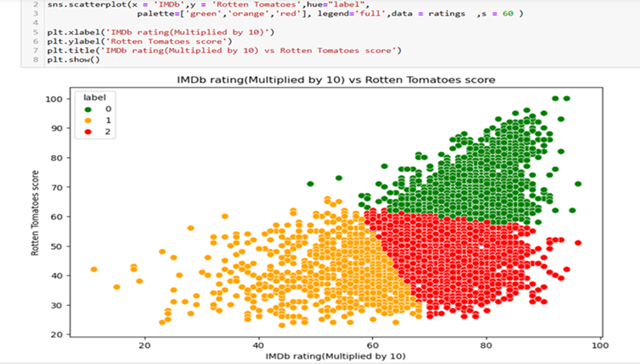

Slide 31
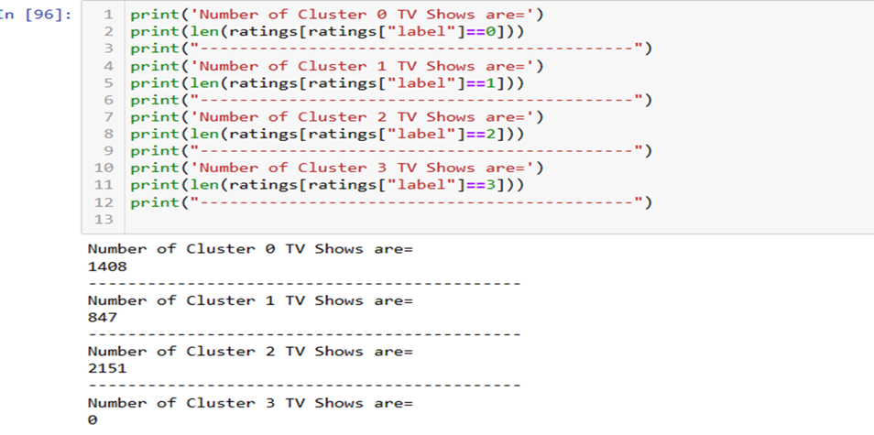

Slide 32
Future Enhancements
Advanced techniques like DBSCAN can improve clustering accuracy and capture complex viewer patterns. Predictive analytics can help forecast trends for better content strategies.
Adding features like watch time and regional preferences provides richer insights, supporting personalized recommendations to enhance user satisfaction.
Automating the process ensures scalability, and dashboards like Tableau can help stakeholders visualize insights for better decisions.

Slide 33
Conclusion
In summary, the project's purpose is to leverage K-means clustering to extract actionable insights from the OTT TV shows dataset, contributing to enhanced content delivery, improved user experiences, and strategic decision-making within the dynamic landscape of over-the-top streaming platforms. The project's findings are expected to contribute to an optimized content ecosystem, enhanced user satisfaction, and strategic decision-making within the dynamic and competitive OTT industry.

Slide 34
References
Saketh Katkam, Abhishek Atikam, Pallerla Mahesh, Mrunal Chatre, Shree Sai Kumar.(2023). Content-based Movie Recommendation System and Sentimental analysis using ML.IEEE.
Alexandra Fanca, Adela Puscasiu, Dan-Ioan Gota, Honoriu Valean.(2020) Recommendation Systems with Machine Learning.IEEE.
Warda Ruheen Bristi, Zakia Zaman, Nishat Sultana.(2019). Predicting IMDb Rating of Movies by Machine Learning Techniques.IEEE.
Vindhya Lingareddy, Madhavi Damle.(2022). Video Streaming OTT Platforms: A Comparative Study of their Streaming Infrastructure with Strategies Implemented.IEEE.
Sundaravel, E. & N., Elangovan. (2020). Emergence and future of Over-the-top (OTT) video services in India: analytical research. International Journal of Business Management and Social Research. 8. 489-499. 10.18801/ijbmsr.080220.50.
Jhala, Bhavyarajsinh Patadiya, Vivek 2021/09/13 120 125A STUDY ON CONSUMER BEHAVIOUR TOWARDS OTT PLATFORMS IN INDIA DURING COVID ERA.
Dwi Gustin Nurdialit, Data Scientist-Published in Analytics Vindhya 2/03/2012-Netflix Movies and TV Shows — Exploratory Data Analysis (EDA) and Visualization Using Python.

Slide 35
THANKYOU:)

